Slide 1
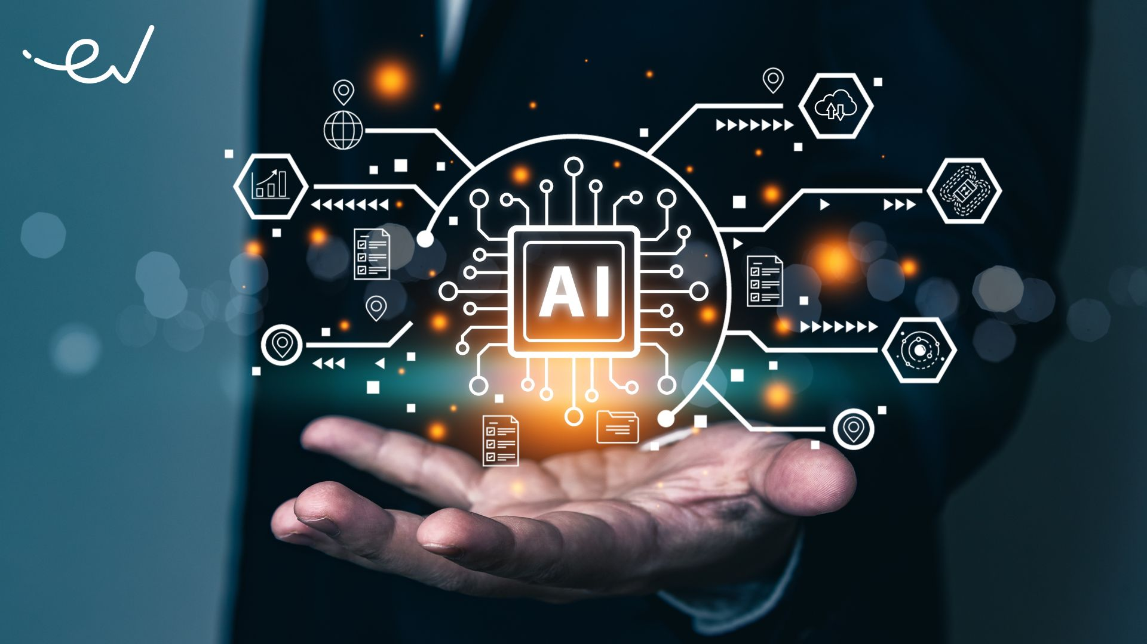

Slide 2
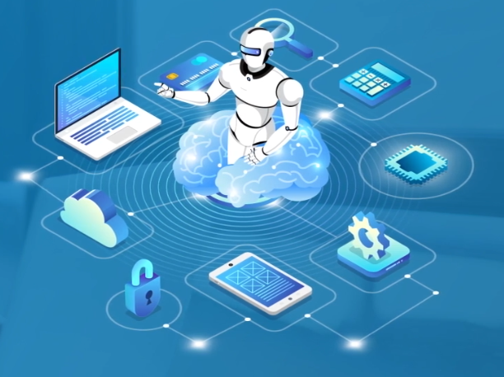
ARTIFICIAL INTELLIGENCE
ROSE MARY THOMAS
Software Engineer Trainee
KOTT Software Pvt Ltd

Slide 3



C O N C E P T
Machine Learning (ML)
Deep Learning
Types
AI
Computer Vision (CV)
Robotics & Autonomous Systems
Main
Branches
INTRODUCTION
What is AI?
Natural Language Processing (NLP)
Example
Applications

Slide 4
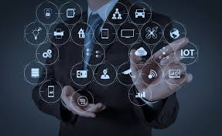
ARTIFICIAL INTELLIGENCE
Computer science the field of AI defines itself as the study of “intelligent agents”.
“Intelligent agents is a system that perceives its environment and takes actions that maximize its chances of success”

Slide 5
AGENTIC AI
Agentic AI is an autonomous artificial intelligence system capable of making decisions and performing complex tasks with minimal human intervention.
It consists of AI agents that perceive, reason, act, learn, and collaborate to achieve specific goals independently, adapting in real-time to new information and obstacles.
Agentic AI is an artificial intelligence system that can accomplish a specific goal with limited supervision. It consists of AI agents—machine learning models that mimic human decision-making to solve problems in real time. In a multiagent system, each agent performs a specific subtask required to reach the goal and their efforts are coordinated through AI orchestration.

Slide 6
EXAMPLE:
In KEKA assistant :
Onboard the new intern joining next Monday
Step 1: Schedule welcome meeting
Step 2: Create intern’s profile in Keka system
Step 3: IT Helpdesk (wifi credentials, email,slacle sccess
Step 4: Order laptop, ID card

Slide 7
Generally, the term “AI” is used when a machine simulate functions that human’s associate with other human minds such as learning and problem solving.
Learn
Recognize
Act

Slide 8
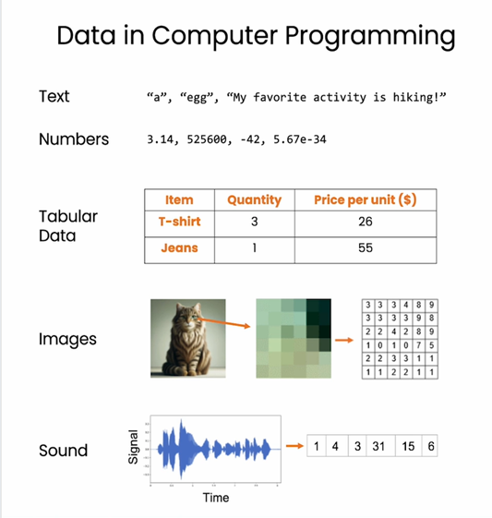

Slide 9
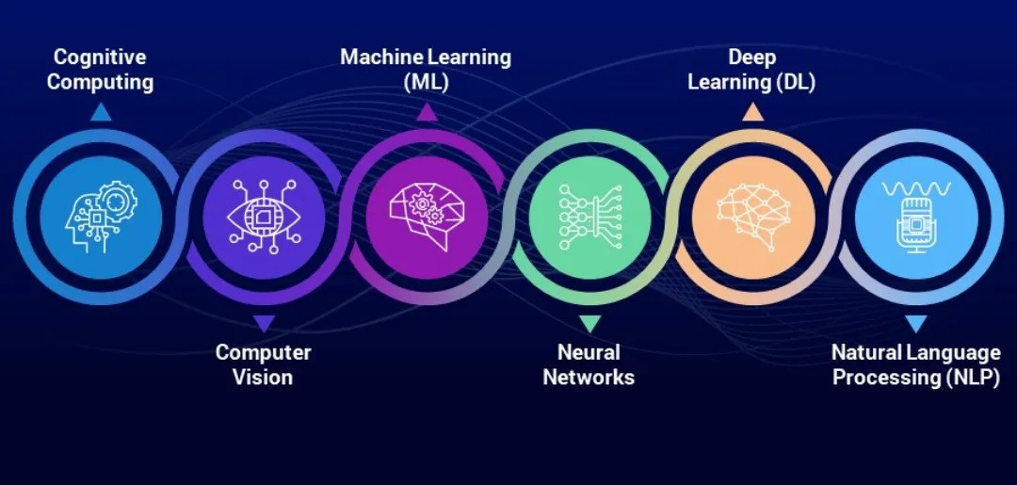
BRANCHES

Slide 10
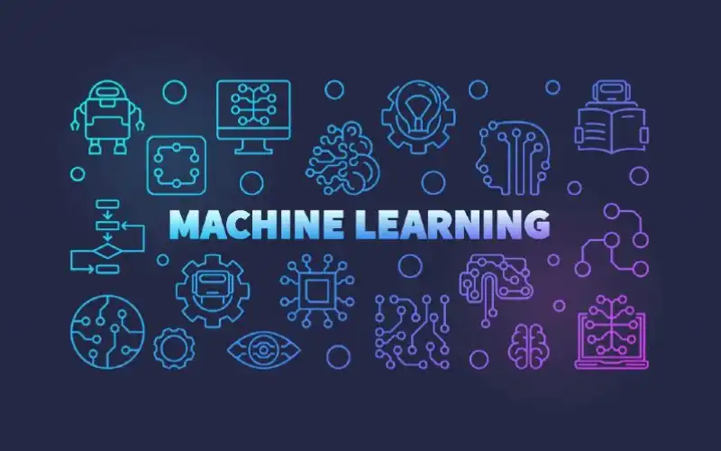
Notes:
Machine Learning is a branch of AI where computers learn patterns from data instead of being explicitly programmed for every rule.
At its heart, Machine Learning is about approximating a function that maps inputs (features) to outputs (labels).
Instead of telling the computer:
If salary > 50000 and credit_score > 700 then approve loan
You give it examples of past loan approvals & rejections, and it figures out the rules by itself.
Mathematically:
Y=f(x)+e
x → Input features (e.g., size of house, number of bedrooms)
y → Output/label (e.g., house price)
f → The function/model we are trying to learn
ϵ\epsilonϵ → Error/noise
Goal → Find the best fsuch that predictions are as close as possible to real outcomes.

Slide 11
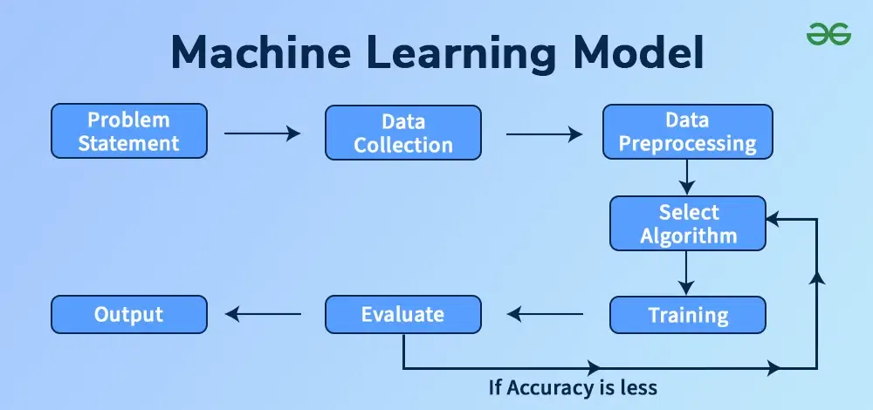

Slide 12


Slide 13
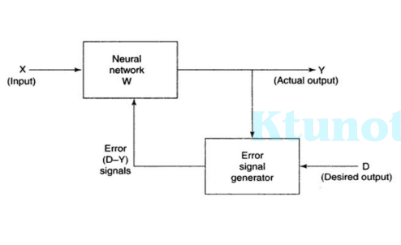
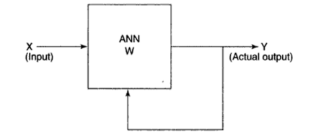
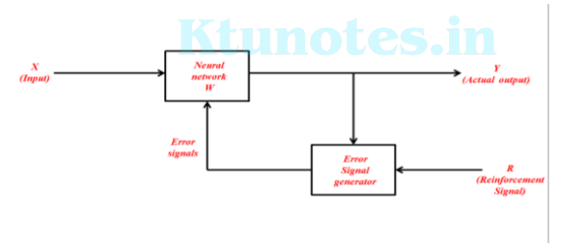

Slide 14
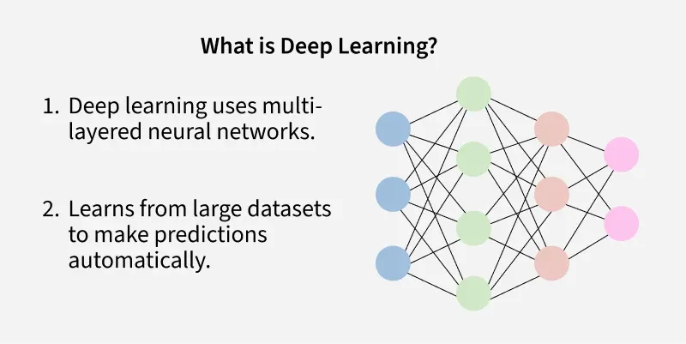
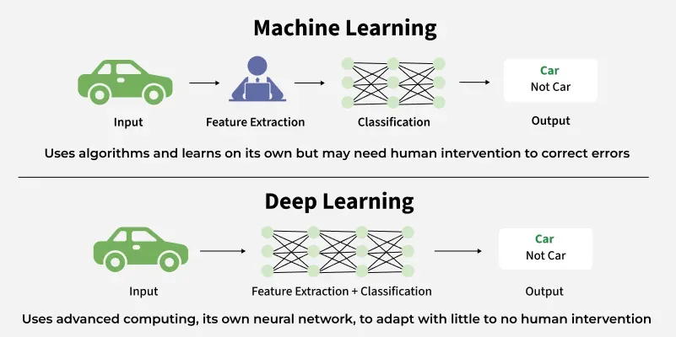

Slide 15
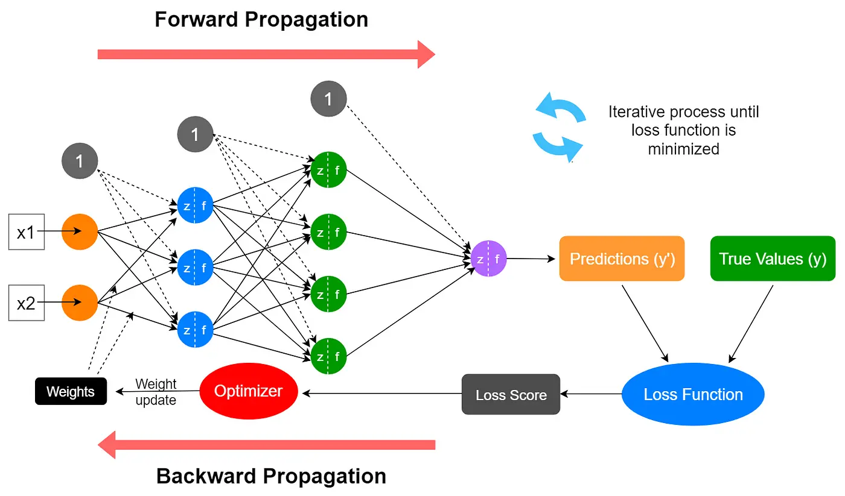
HOW DOES NEURAL NETWORK WORKS?

Slide 16
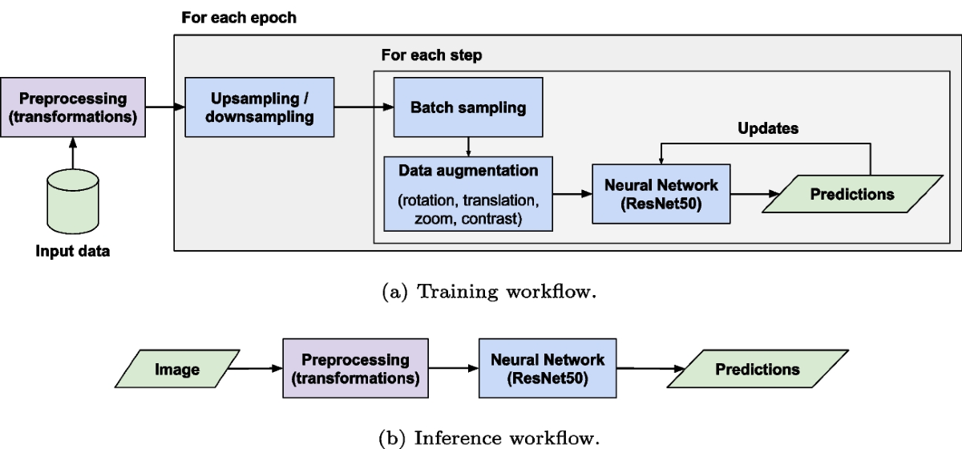

Slide 17
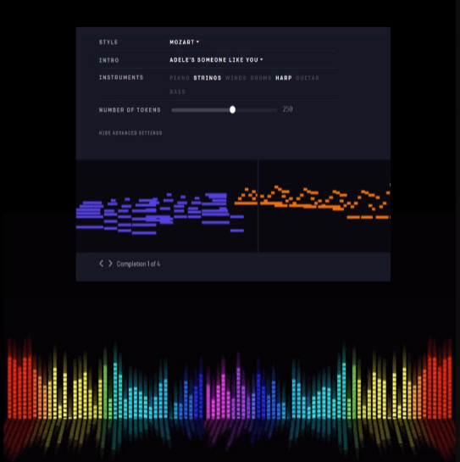
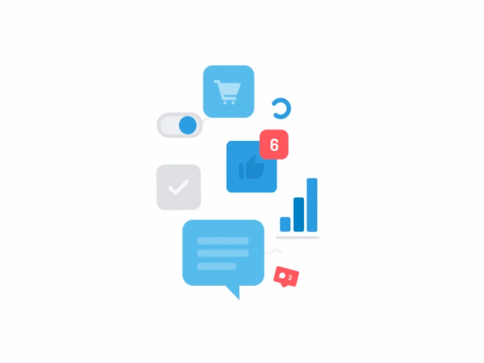
10. AI IN ARTIFICIAL CREATIVITY
MuseNet
MuseNet, a deep neural network that can generate 4- minute musical compositions with 10 different instruments.
Wordsmith
Wordsmith is an AI- powered tool that produces written analytics by transforming the given data.
9. AI IN SOCIAL MEDIA
Facebook
Facial features, Machine Learning & Deep Learning to detect facial features and tag your friends

Slide 18
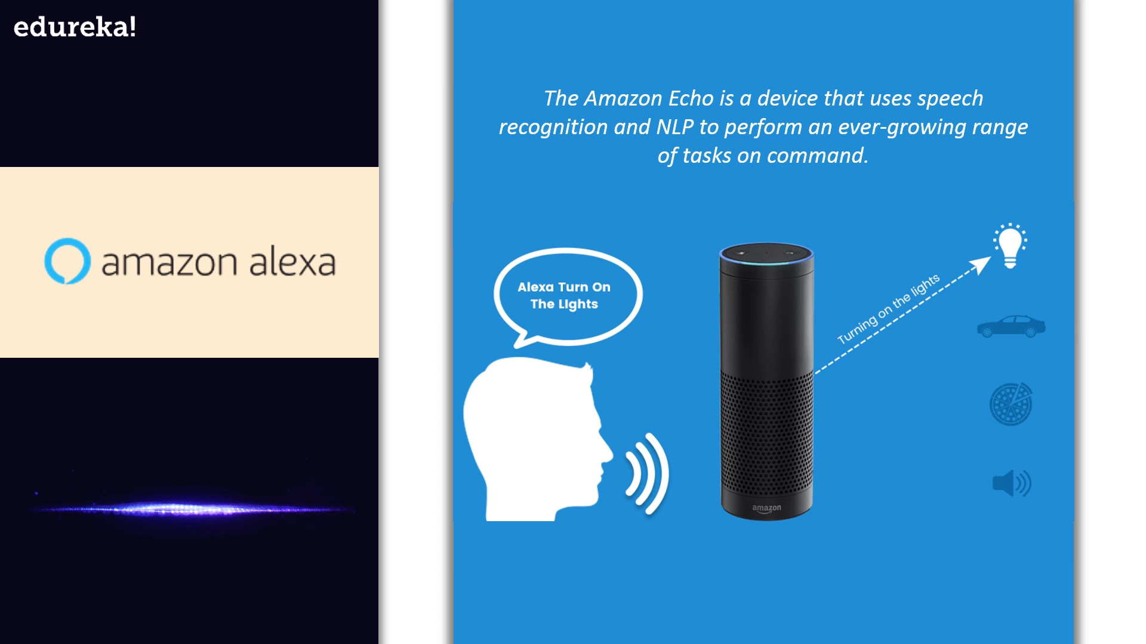
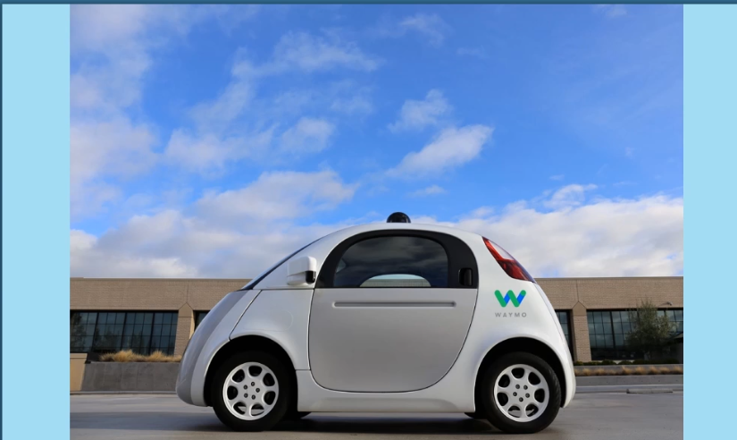
8. AI IN CHATBOTS
7. AI IN AUTONOMOUS VEHICLES
Amazon Alexa
Waymo
Waymos AI software crunches data from the vehicles’ lidar to produce control signals that operate the driverless vehicle
The Amazon Echo is a device that uses speech recognition and NLP to perform an ever- growing range of tasks on command
Google Assistant
Tesla
Tesla will have fully self-driving cars ready by the end of the year and a “robo taxi” version – one that can ferry pasengers without anyone behind the wheel ready for the streets next year
Google Assistant is designed to have conversations with you in order to complete tasks. It uses AI to process natural language and perform tasks like book appointments and make calls.

Slide 19
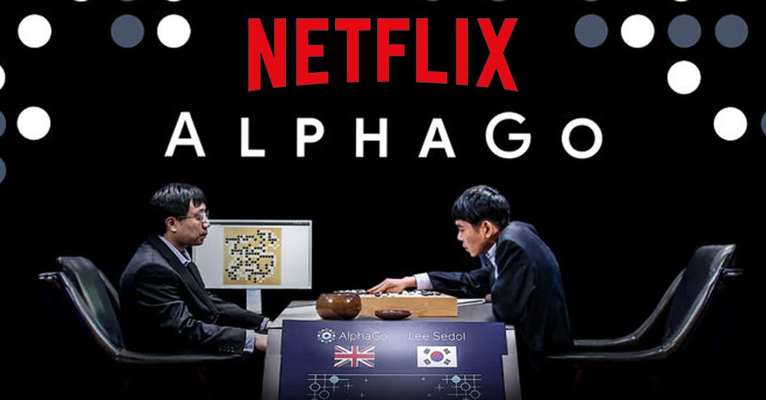
6. AI IN SPACE EXPLORATION
5. AI IN GAMING
The known AI AEGIS is on the red planet onboard NASA’s current rovers. It is developed to handle autonomous targeting of cameras and choose what to investigate
Astronomers Used I To Sift Through Years Of Data Obtained By The Kepler Telescope To Identify A Distant Eight Planet Solar System
F.E.A.R

Slide 20

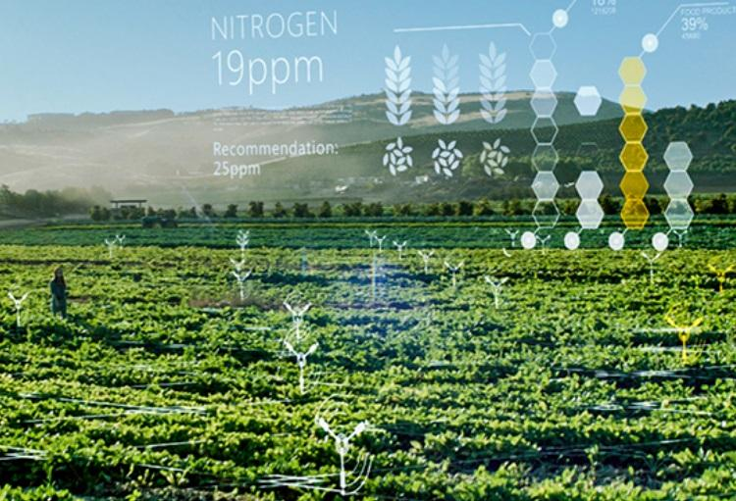

4. AI IN BANKING AND FINANCE
3. AI IN AGRICULTURE
Pantix
Blue river

Slide 21
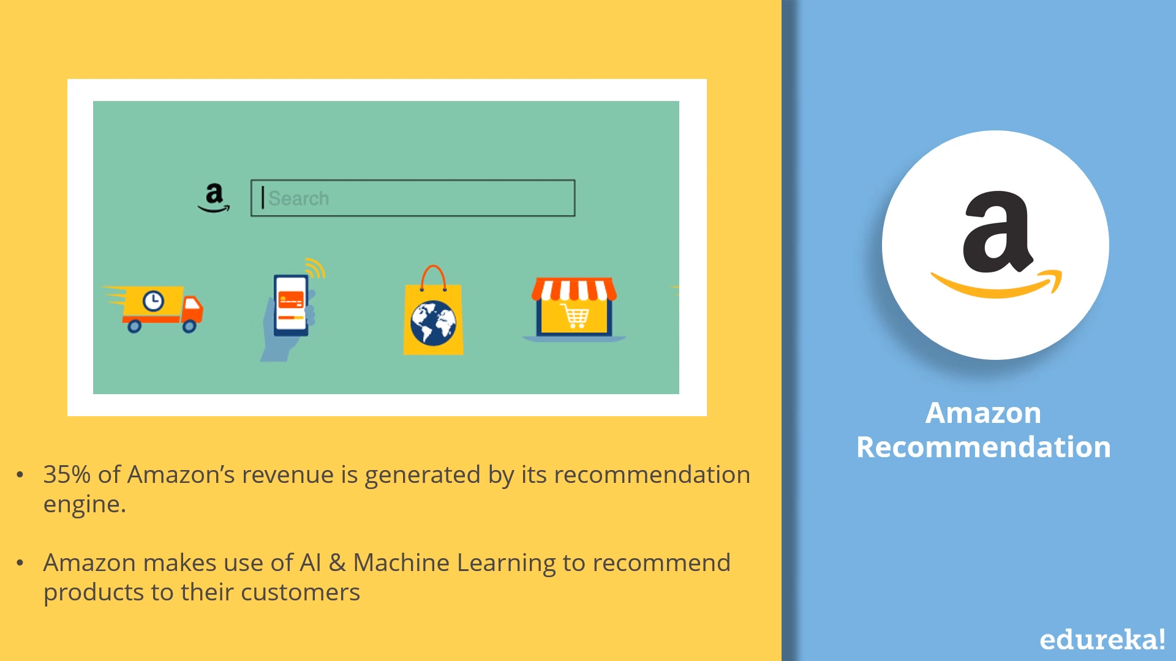
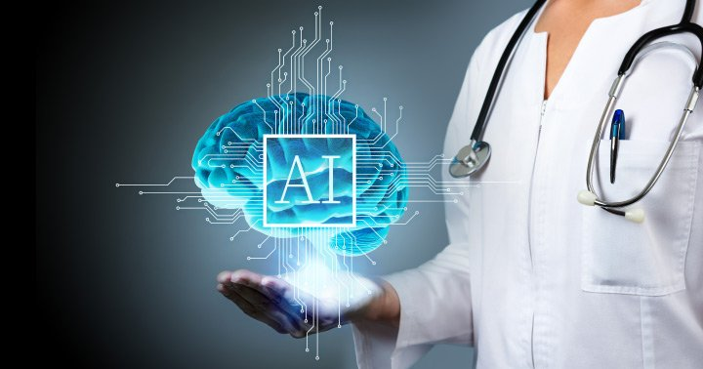
1. AI IN MARKETING
2. AI IN HEALTHCARE
Amazon
IBM Watson
NETFLIX
DeepMind

Slide 22
T H A N K YOU

